Slide 1
Honeywell
Project Review

Slide 2
Login Window with OTP Verification
Team Members
Rohit Raj and Ritik

Slide 3

Problem Statement
Traditional login systems are often vulnerable to security breaches, as they solely rely on username-password combinations.
This project aims to address this issue by implementing an additional layer of security through OTP verification.

Slide 4
Solution
We built a login window to provide a secure and efficient login mechanism using OTP verification.
Achieving these objectives, we aim to enhance user trust and mitigate the risk of unauthorized access.

Slide 5
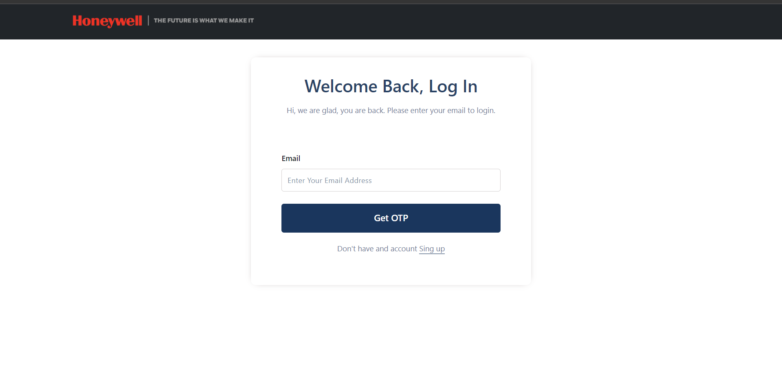
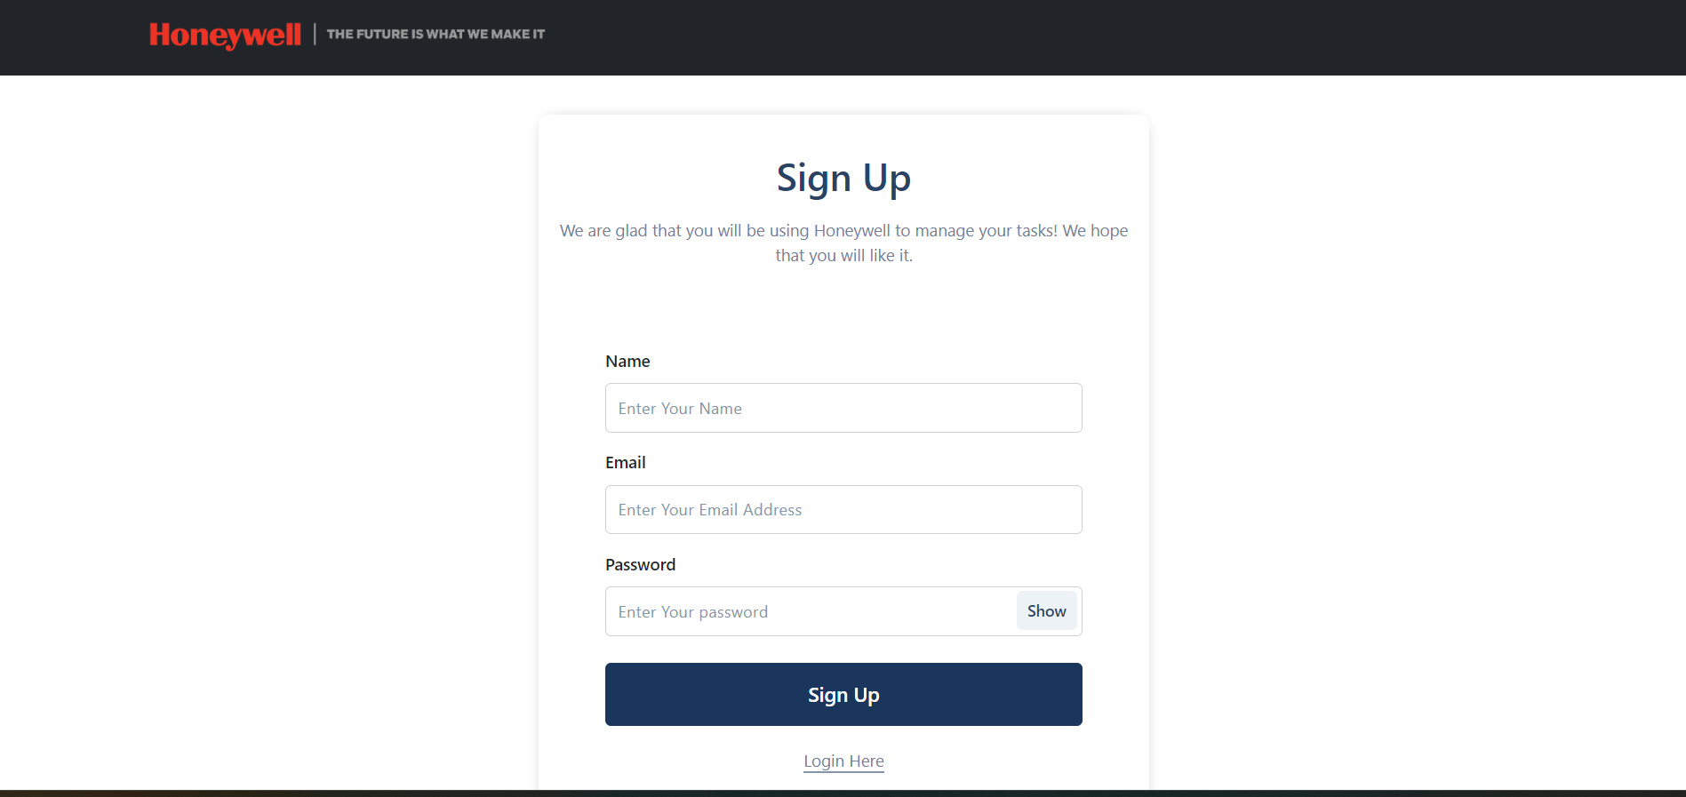
Overview of Website
Login Page
Sign Up page

Slide 6

Tech Stack Used

Slide 7
Implementation Details
User Registration
Users provide their email addresses and passwords during the registration process.
The password is securely hashed and stored in the MongoDB database.
A unique token ID is generated and associated with the user.
OTP Generation and Delivery:
When a user attempts to log in, an OTP is generated and stored in the database.
The OTP is sent to the user's registered email address via an email service provider using Nodemailer
OTP Verification
Users enter the OTP received in their email to verify their identity.
The entered OTP is validated against the one stored in the database.
If the OTP is valid and has not expired, the user is granted access.

Slide 8
Future Implementation
Adding social media login options (e.g., Gmail, Github account) for user convenience
Developing an admin dashboard for user management and analytics

Slide 9
Conclusion and Work Outcomes
Strengthening security through OTP verification
Utilizing the MERN stack for efficient web application development
Integrating third-party services (email service provider) for seamless communication
Employing secure hashing techniques for password storage

Slide 10
Thanks!
We highly acknowledge your feedback

